Slide 1
Parallel and Distributed Databases

Slide 2
Syllabus Content
Parallel Database:
Architecture, I/O Parallelism, Interquery, Intraquery
Intraoperation and Interoperation Parallelism
Distributed Databases
Types of Distributed Database Systems,
Distributed Data Storage, Distributed Query Processing

Slide 3
Parallel DBMS
Parallel DBMS is a Database Management System that runs through multiple processors and disks.
They combine two or more processors also disk storage that helps make operations and executions easier and faster.
A parallel server can allow access to a single database by users on multiple machines. It also performs many parallelization operations like data loading, query processing, building indexes, and evaluating queries.
Notes:
A parallel database, for example, allows a large online retailer to have thousands of requests of users accessing information at the same time. This level of processing performance is not possible with single server systems.

Slide 4
Working of parallel database
Parallel processing divides a large task into many smaller tasks and executes the smaller tasks concurrently on several CPU’s and completes it more quickly.
The driving force behind parallel database systems is the demand of applications that have to query extremely large databases of the order of terabytes or that have to process a large number of transactions per second.
In parallel processing, many operations are performed simultaneously as opposed to serial processing, in which the computational steps are performed sequentially.

Slide 5
Advantages of Parallel Databases
Performance Improvement – By connecting multiple resources like CPU and disks in parallel we can significantly increase the performance of the system.
High availability – In the parallel database, nodes have less contact with each other, so the failure of one node doesn’t cause for failure of the entire system. This amounts to significantly higher database availability.
Proper resource utilization – Due to parallel execution, the CPU will never be ideal. Thus, proper utilization of resources is there.
Increase Reliability – When one site fails, the execution can continue with another available site which is having a copy of data. Making the system more reliable.
Notes:
Speedup – The ability to execute the tasks in less time by increasing the number of resources is called Speedup.
Speedup=time original/time parallel Where , time original = time required to execute the task using 1 processor time parallel = time required to execute the task using 'n' processors
Scale-up – The ability to maintain the performance of the system when both workload and resources increase proportionally.
Scaleup = Volume Parallel/Volume Original
Example – 20 users are using a CPU at 100% efficiency. If we try to add more users, then it’s not possible for a single processor to handle additional users. A new processor can be added to serve the users parallel. And will provide 200% efficiency.

Slide 6
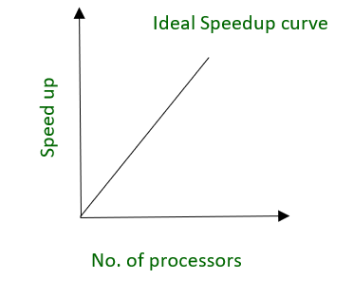
Speed up and Scale up
The ability to execute the tasks in less time by increasing the number of resources is called Speedup.
Speedup =time original/time parallel
Where ,
time original = time required to execute the task using 1 processor
time parallel = time required to execute the task using 'n' processors
fig. Ideal Speedup curve

Slide 7
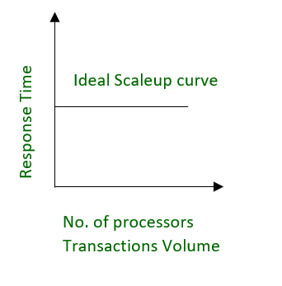
Speed up and Scale up
Scaleup means the ability to maintain the performance of the system when both workload and resources increase proportionally.
Scaleup = Volume Parallel/Volume Original
Where ,
Volume Parallel = volume executed in a given amount of time using 'n' processor
Volume Original = volume executed in a given amount of time using 1 processor
fig. Ideal Scaleup curve

Slide 8
Parallel Database-Architectural Models
Architectural Models
There are several architectural models for parallel Database, which are given below −
Shared memory architecture.
Shared disk architecture.
Shared nothing architecture.
Notes:
Large scale parallel database systems are increasingly used for:
- for storing large volumes of data
-processing time consuming decision support queries
-providing high throughout for transaction processing
Parallelism in a query allows us to parallel execution of multiple queries by decomposing them into the parts that work in parallel.

Slide 9
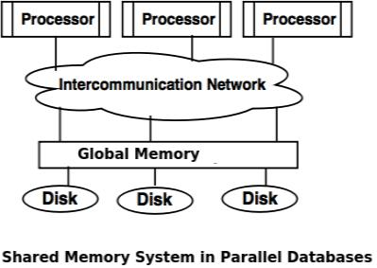
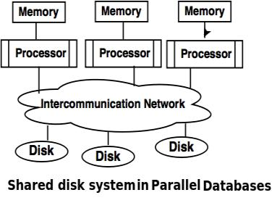
Parallel Database
Shared Memory System
Every computer processor is able to access and process data from common memory modules or unit through intercommunication channel.
This architecture is also commonly known as SMP or Symmetric Multi-processing
Shared Disk System
A Shared Disk System is an architecture of Database Management System where every computer processors can access multiple disk through intercommunication network.
It can also access and utilize every local memory.
Notes:
Advantages of Shared Memory:
Data is easily accessed from various processors.
A single processor can send messages to other processors efficiently.
Disadvantage of Shared Memory:
Waiting time for every single processor increases when all of them are uses.
Bandwidth is also a problem
------------------------------------------------------------------------------------------------------------------------------------------
Advantages of Shared Disk System:
The fault tolerance can be achieved using this system. Eliminates Single Points of Failure
Disadvantages of Shared Disk System:
The addition of processors can slow down existing processors.
Shared Disk System have a limited scalability meaning it is sometimes fixed.

Slide 10
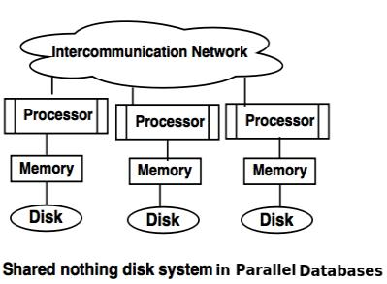
Parallel Database
Shared Nothing System
A Shared Nothing System is an architecture of Database Management System where every processor has their own disk and memory for the objective of efficient workflows.
The processors can communicate with other processors using intercommunication network.
Each of the processors act like servers to store data on the disk.
Notes:
he nodes are independent and self-sufficient as they have their own disk space and memory.
Advantage of Shared Nothing System
This system has more scalability.
Number of processors and disk can be connected as per the requirement in share nothing disk system.
Disadvantage of Shared Nothing system
Must require the partitioning of data.
Cost that need for this system is higher.

Slide 11
I/O parallelism in parallel database- Partitioning
Parallel I/O refers to the process of writing to, or reading from, two or more I/O devices simultaneously; it can result in significant improvements in throughput. This can be achieved through partitioning.
Horizontal Fragmentation –In horizontal partitioning, the tuples of a relation are divided (or declustered) among many disks, so that each tuple resides on one disk.
Partitioning the tables using the conditions specified through WHERE clause of SQL query to distribute bunch of tuples (records). For example, consider the following schema;
STUDENT (Regno, SName, Address, Branch, Phone)
In this table, Branch column is used to store the academic branch in which the student admitted in. suppose, there are various branches like ‘BTech CIVIL’, ‘BTech MECH’, ‘BTech CSE’, and so on, then the following query would be used to partition the table using horizontal partitioning.
SELECT * FROM student WHERE Branch = branch name;
In the result, there won’t be any changes in the schema of the table; i.e the structure of the table is unaltered. Only, ‘BTech CIVIL’ students fragmented into one partition, ‘BTech CSE’ students fragmented into one partition and so on.
Notes:
It is a form of parallelism in which the relations are partitioned on multiple disks a motive to reduce the retrieval time of relations from the disk. Within, the data inputted is partitioned and then processing is done in parallel with each partition. The results are merged after processing all the partitioned data. It is also known as data-partitioning.

Slide 12
I/O parallelism in parallel database -Partitioning
Vertical Fragmentation – Partitioning tables using the decomposition rules to break and distribute the tables into multiple partitions vertically (different schemas) is called Vertical fragmentation.
For example, if we would like to break STUDENT into different tables like STUDENT(Regno, SName, Address, Branch) and STU_PHONE(Regno, Phone), i.e into two different schema on columns is Vertical partitioning.

Slide 13
Partitioning Techniques
There are various partitioning strategies proposed to manage the data distribution into multiple processors evenly.
Round-robin.
This strategy scans the relation in any order and sends the ith tuple to disk number i mod n.
The round-robin scheme ensures an even distribution of tuples across disks; that is, each disk has approximately the same number of tuples as the others.
For example:
If the number of available disks n is 10, then first record goes to D1 (1 mod 10 = 1), second record goes to D2 (2 mod 10 =2), and so on and 10th record goes to D0 (10 mod 10 = 0), 11th record goes to D1 (11 mod 10 = 1). This scheme distributes data evenly in all the disks.

Slide 14
Partitioning Techniques
Hash partitioning.
This declustering strategy designates one or more attributes from the given relation’s schema as the partitioning attributes.
A hash function is chosen whose range is {0, 1, . . . , n − 1}. Each tuple of the original relation is hashed on the partitioning attributes. If the hash function returns i, then the tuple is placed on disk Di.
For example, consider the following table;
EMPLOYEE(ENo, EName, DeptNo, Salary, Age)
If we choose DeptNo attribute as the partitioning attribute and if we have 10 disks to distribute the data, then the following would be a hash function;
h(DeptNo) = DeptNo mod 10
If we have 10 departments, then according to the hash function, all the employees of department 1 will go into disk 1, department 2 to disk 2 and so on.
As another example, if we choose the EName of the employees as partitioning attribute, then we could have the following hash function;
h(EName) = (Sum of ASCII value of every character in the name) mod n,
where n is the number of disks/partitions needed.

Slide 15
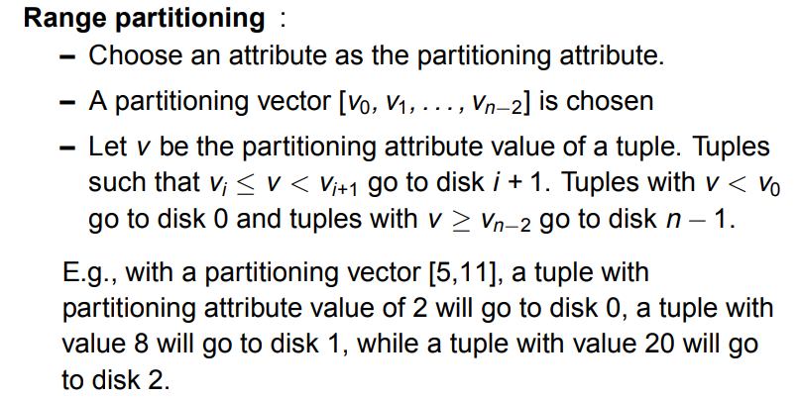
Notes:
– Provides data clustering by partitioning attribute value.

Slide 16
Range Partitioning
For example, for the EMPLOYEE relation given above, if the partitioning attribute is Salary, then the vector would be one as follows;
[5000, 15000, 30000],
where every value means the individual range of salaries. That is, 5000 represents the first range (0 – 5000), 15000 represents the range (5001 – 15000), 30000 represents the third range (15001 – 30000), and it includes the final range which is (30001 – rest). Hence, the vector with 3 values represents 4 disks/partitions.
The above discussed partition strategies must be chosen carefully according to the workload of your parallel database system. The workload may involve many components like, which attribute is frequently used in any queries as filtering condition, the number of records in a table, the size of the database, approximate number of incoming queries in a day, etc.

Slide 17
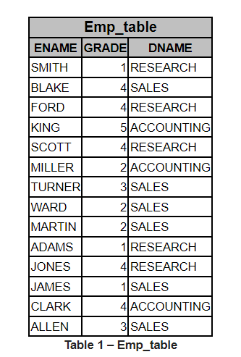
Partitioning example
Perform following partitioning techniques.
A. Round-Robin Partitioning
B. Hash Partitioning
C. Range Partitioning

Slide 18
Interquery and Intraquery parallelism
Interquery Parallelism
In interquery parallelism, different queries or transaction execute in parallel with one another.
This form of parallelism can increase transactions throughput. The response times of individual transactions are not faster than they would be if the transactions were run in isolation.
Thus, the primary use of interquery parallelism is to scale up a transaction processing system to support a more significant number of transactions per second.
Interquery parallelism is the easiest form of parallelism to support in a database system—particularly in a shared-memory parallel system.
Notes:
Advantages
It increases Transaction Throughput. That is, number of transactions executed in a given time can be increased.
It scales up the Transaction processing system. Hence, best suited for On-Line Transaction Processing (OLTP) systems.
Supported Parallel Database Architectures
It is easy to implement in Shared Memory Parallel System. Lock tables and Log information are maintained in the same memory. Hence, it is easy to handle those transactions which shares locks with other transactions. Locking and logging can be done efficiently.

Slide 19
Interquery and Intraquery parallelism
Intraquery Parallelism
Intraquery parallelism defines the execution of a single query in parallel on multiple processors and disks.
Using intraquery parallelism is essential for speeding up long-running queries.
This application of parallelism decomposes the serial SQL, query into lower-level operations such as scan, join, sort, and aggregation.
To illustrate the parallel evaluation of a query, consider a query that requires a relation to be sorted. Suppose that the relation has been partitioned across multiple disks by range partitioning on some attribute, and the sort is requested on the partitioning attribute. The sort operation can be implemented by sorting each partition in parallel, then concatenating the sorted partitions to get the final sorted relation.
Notes:
Advantages
To speed up a single complex long running queries.
Best suited for complex scientific calculations (queries).
Example Database systems which support Intra-query Parallelism
Informix, Terradata

Slide 20
Intraoperation and Interoperation Parallelism
we may be able to pipeline the output of one operation to another operation. The two operations can be executed in parallel on separate processors,
one generating output that is consumed by the other, even as it is generated.
In summary, the execution of a single query can be parallelized in two ways:
Intraoperation parallelism.
We can speed up processing of a query by parallelizing the execution of each individual operation, such as sort, select, project, and join.
Interoperation parallelism.
We can speed up processing of a query by executing in parallel the different operations in a query expression.

Slide 21
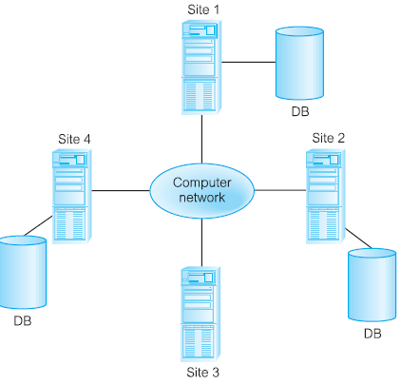
Distributed Databases
What is a distributed database?
Distributed database system is one in which the data belonging to a single logical database is distributed to two or more physical databases to ensure reliability and availability
A distributed database is a database in which all storage devices are not attached to a common CPU. Data may be stored in multiple sites separate from each other.
In a distributed database, the data is spread or replicated among several databases which are physically separate from each other. These databases are connected through a network so that they appear as a single database to the user.

Slide 22
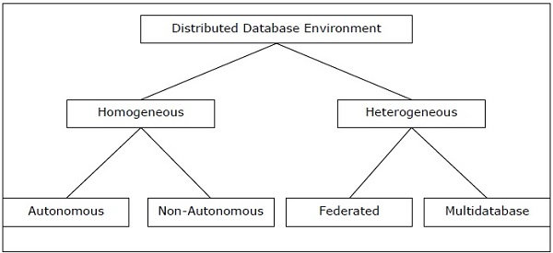
Types of Distributed Databases
Distributed databases can be broadly classified into homogeneous and heterogeneous distributed database environments
Homogeneous Distributed Databases
In a homogeneous distributed database, all the sites use identical DBMS and operating systems. Its properties are
The sites use very similar software.
The sites use identical DBMS or DBMS from the same vendor.
Each site is aware of all other sites and cooperates with other sites to process user requests.
The database is accessed through a single interface as if it is a single database.

Slide 23
Types of Distributed Databases
There are two types of homogeneous distributed database are:
Autonomous − Each database is independent that functions on its own. They are integrated by a controlling application and use message passing to share data updates.
Non-autonomous − Data is distributed across the homogeneous nodes and a central or master DBMS co-ordinates data updates across the sites.

Slide 24
Types of Distributed Databases
Heterogeneous Distributed Databases
In a heterogeneous distributed database, different sites have different operating systems, DBMS products and data models. Its properties are −
Different sites use dissimilar schemas and software.
The system may be composed of a variety of DBMSs like relational, network, hierarchical or object oriented.
Query processing is complex due to dissimilar schemas.
Transaction processing is complex due to dissimilar software.
A site may not be aware of other sites and so there is limited co-operation in processing user requests.

Slide 25
Types of Distributed Databases
Types of Heterogeneous Distributed Databases
Federated − The heterogeneous database systems are independent in nature and integrated together so that they function as a single database system.
Un-federated − The database systems employ a central coordinating module through which the databases are accessed.

Slide 26
Distributed Data Storage
Distributed Data storage is an intelligent distribution of your data pieces, (called data fragments) to improve database performance and Data Availability for end-users.
It aims to reduce overall costs of transaction processing while also providing accurate data rapidly in your DDBMS systems.
Distributed Data storage is one of the key steps in building your Distributed Database Systems.
There are two common strategies used in optimal Data Allocation: Data Fragmentation and Data Replication.

Slide 27
Distributed Data Storage
Fragmentation – In this approach, the relations are fragmented (i.e., they’re divided into smaller parts) and each of the fragments is stored in different sites where they’re required.
Fragmentation is a process of disintegrating relations or tables into several partitions in multiple sites. It divides a database into various subtables and sub relations so that data can be distributed and stored efficiently. Fragmentation of relations can be done in two ways:
Horizontal fragmentation– Splitting by rows – The relation is fragmented into groups of tuples so that each tuple is assigned to at least one fragment.
For example, in the student schema, if the details of all students of Computer Science Course needs to be maintained at the School of Computer Science, then the designer will horizontally fragment the database as follows −
CREATE COMP_STD AS
SELECT * FROM STUDENT
WHERE COURSE = "Computer Science";

Slide 28
Distributed Data Storage
Vertical fragmentation – Splitting by columns –
The schema of the relation is divided into smaller schemas. Each fragment must contain a common candidate key so as to ensure a lossless join.
In certain cases, an approach that is hybrid of fragmentation and replication is used.
For example, let us consider that a University database keeps records of all registered students in a Student table having the following schema.
STUDENT
Now, the fees details are maintained in the accounts section. In this case, the designer will fragment the database as follows −
CREATE TABLE STD_FEES AS
SELECT Regd_No, Fees
FROM STUDENT;
Regd_No | Name | Course | Address | Semester | Fees | Marks

Slide 29
Distributed Data Storage
Hybrid Fragmentation
In hybrid fragmentation, a combination of horizontal and vertical fragmentation techniques are used.
Hybrid fragmentation can be done in two alternative ways −
At first, generate a set of horizontal fragments; then generate vertical fragments from one or more of the horizontal fragments.
At first, generate a set of vertical fragments; then generate horizontal fragments from one or more of the vertical fragments.

Slide 30
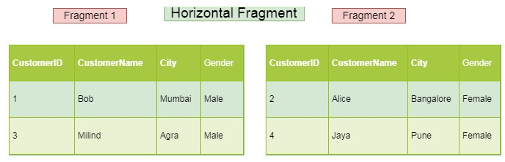
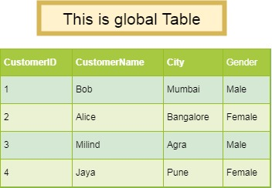
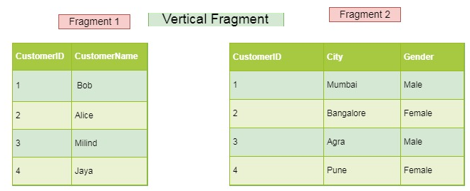
Distributed Data Storage
Fragmentation Example

Slide 31
Distributed Data Storage
Replication – In this approach, the entire relationship is stored redundantly at 2 or more sites. If the entire database is available at all sites, it is a fully redundant database. Hence, in replication, systems maintain copies of data.
This is advantageous as it increases the availability of data at different sites.
However, it has certain disadvantages as well. Data needs to be constantly updated. Any change made at one site needs to be recorded at every site that relation is stored or else it may lead to inconsistency. This is a lot of overhead. Also, concurrency control becomes way more complex as concurrent access now needs to be checked over a number of sites.
Advantages of Data Replication
Reliability − In case of failure of any site, the database system continues to work since a copy is available at another site(s).
Reduction in Network Load − Since local copies of data are available, query processing can be done with reduced network usage, particularly during prime hours. Data updating can be done at non-prime hours.
Quicker Response − Availability of local copies of data ensures quick query processing and consequently quick response time.
Simpler Transactions − Transactions require less number of joins of tables located at different sites and minimal coordination across the network. Thus, they become simpler in nature.

Slide 32
Distributed Data Storage
Types of Data Replication In DBMS
Transactional Replication
Snapshot Replication
Merge Replication
Transactional Replication
Transactional Replication makes a complete copy of your database, as well as copies of new data changes. In this type of Data Replication, changes to your database are synced in real-time and in the same order as they occur. This guarantees transactional consistency.
Snapshot Replication
Snapshot Replication is perhaps the simplest type of Data Replication that copies “snapshots” of your database. It replicates the current state of your database as is, at a specific point in time, without including any changes/updates to your data. This kind of replication is helpful when changes made to your databases are infrequent.
Merge Replication
Merge Replication combines data from several databases into a single database. This type of Data Replication tracks subsequent data changes and schema modifications made at publishers and subscribers and synchronizes the same to your database using merge agents. A great advantage of using Merge Replication is that it allows publishers and subscribers to independently modify the database.

Slide 33
Query Processing in Distributed DBMS
Query processing in a distributed database management system requires the transmission of data between the computers in a network.
Query processing in DBMS is different from query processing in centralized DBMS due to the communication cost of data transfer over the network.
The transmission cost is low when sites are connected through high-speed Networks and is quite significant in other networks.

Slide 34
1. Costs (Transfer of data) of Distributed Query processing :
In Distributed Query processing, the data transfer cost of distributed query processing means the cost of transferring intermediate files to other sites for processing and therefore the cost of transferring the ultimate result files to the location where that result’s required.
Let’s say that a user sends a query to site S1, which requires data from its own and also from another site S2. Now, there are three strategies to process this query which are given below:
We can transfer the data from S2 to S1 and then process the query
We can transfer the data from S1 to S2 and then process the query
We can transfer the data from S1 and S2 to S3 and then process the query. So the choice depends on various factors like, the size of relations and the results, the communication cost between different sites, and at which the site result will be utilized.

Slide 35
Commonly, the data transfer cost is calculated in terms of the size of the messages. By using the below formula, we can calculate the data transfer cost:
Data transfer cost = C * Size Where C refers to the cost per byte of data transferring and Size is the no. of bytes transmitted.
2. Using Semi join in Distributed Query processing :
The semi-join operation is used in distributed query processing to reduce the number of tuples in a table before transmitting it to another site. This reduction in the number of tuples reduces the number and the total size of the transmission ultimately reducing the total cost of data transfer.

